Slide 1
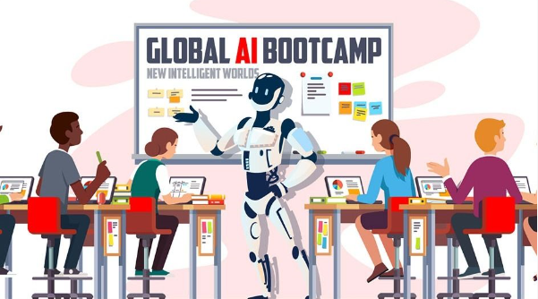

Slide 2
Power BI + AI
Vivek Patel

Slide 3
Power BI + AI
-New AI Capabilities
-Quick Insight and -Q&A in services
-Bookmark, Spotlight
-Drill Through
-Right click and Explain Increase --> Select Different chart
-Q&A in Desktop
-Improving Q&A
-POPup Q&A
-Followup Question

Slide 4

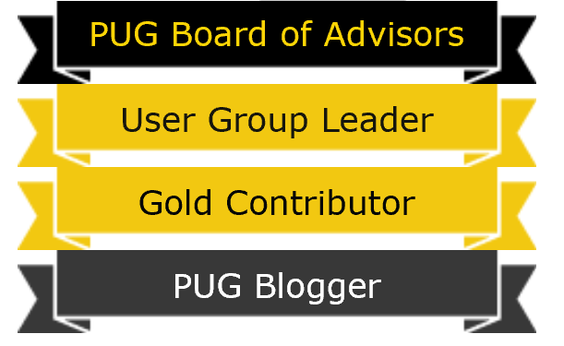






Vivek Patel
Founder at Insight2Actions Inc.
Leader:-Toronto Power BI, Power Apps, Flow user group
Data Platform MVP
Power BI User Group Board of Advisors (Member)
Organizing Committee – Power BI World Tour 2017(Toronto) and 2018(Montreal)
Work
Process automation utilizing the latest offerings from the Microsoft business intelligence platform.
Primary focus is to provide end to end Business process automation solution by designing applications that measure and provide insight, Take actions from insight and automate workflow.
Frequently provides consulting/training to BI professional.
Speaker - local/International Business intelligence events.
Very passionate about Microsoft Data platform offering. Area of expertise Power BI, PowerApps and Microsoft Flow

Slide 5
Power BI Differentiator

Slide 6
Power BI Differentiator
abc

Slide 7
Power BI Differentiator
Get dashboards in minutes
Natural language query
Quick Insights
Cortana integration
Live dashboards
Custom visualizations
Publish to the web
Integration with Microsoft apps & services
Power BI Mobile
abc

Slide 8

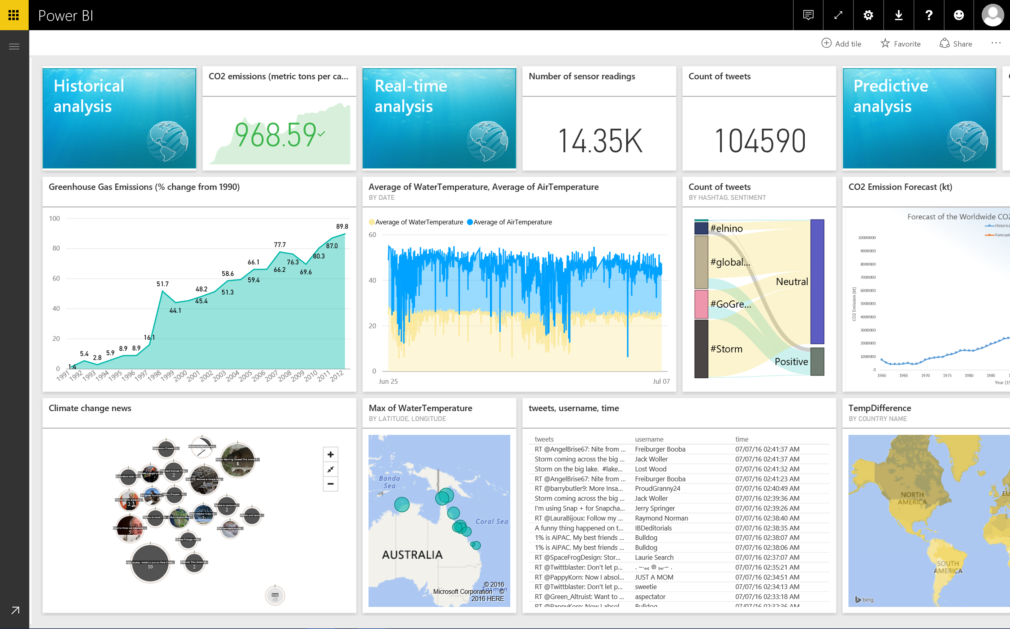
Get dashboards
in minutes
abc

Slide 9
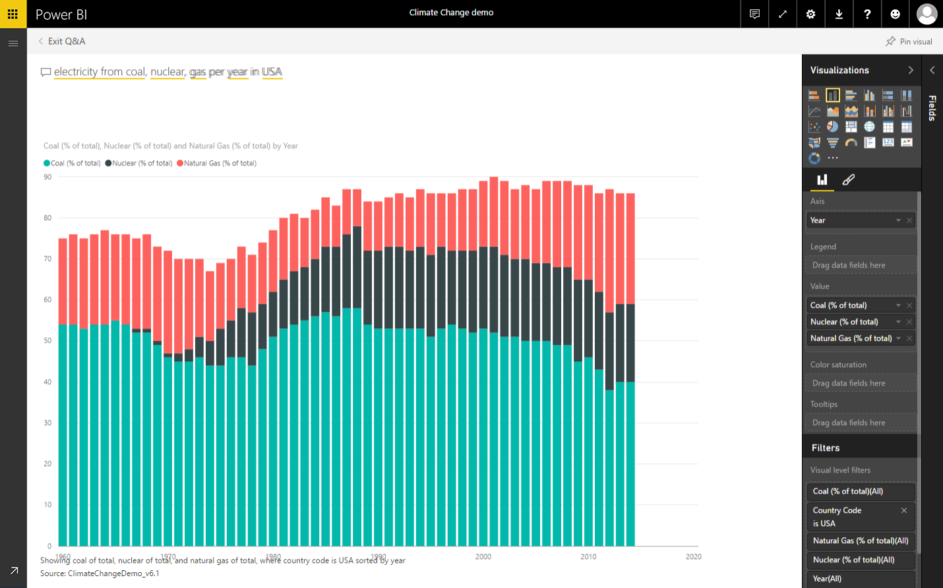
Natural language query
Electricity from coal, nuclear, gas per year in USA
abc

Slide 10
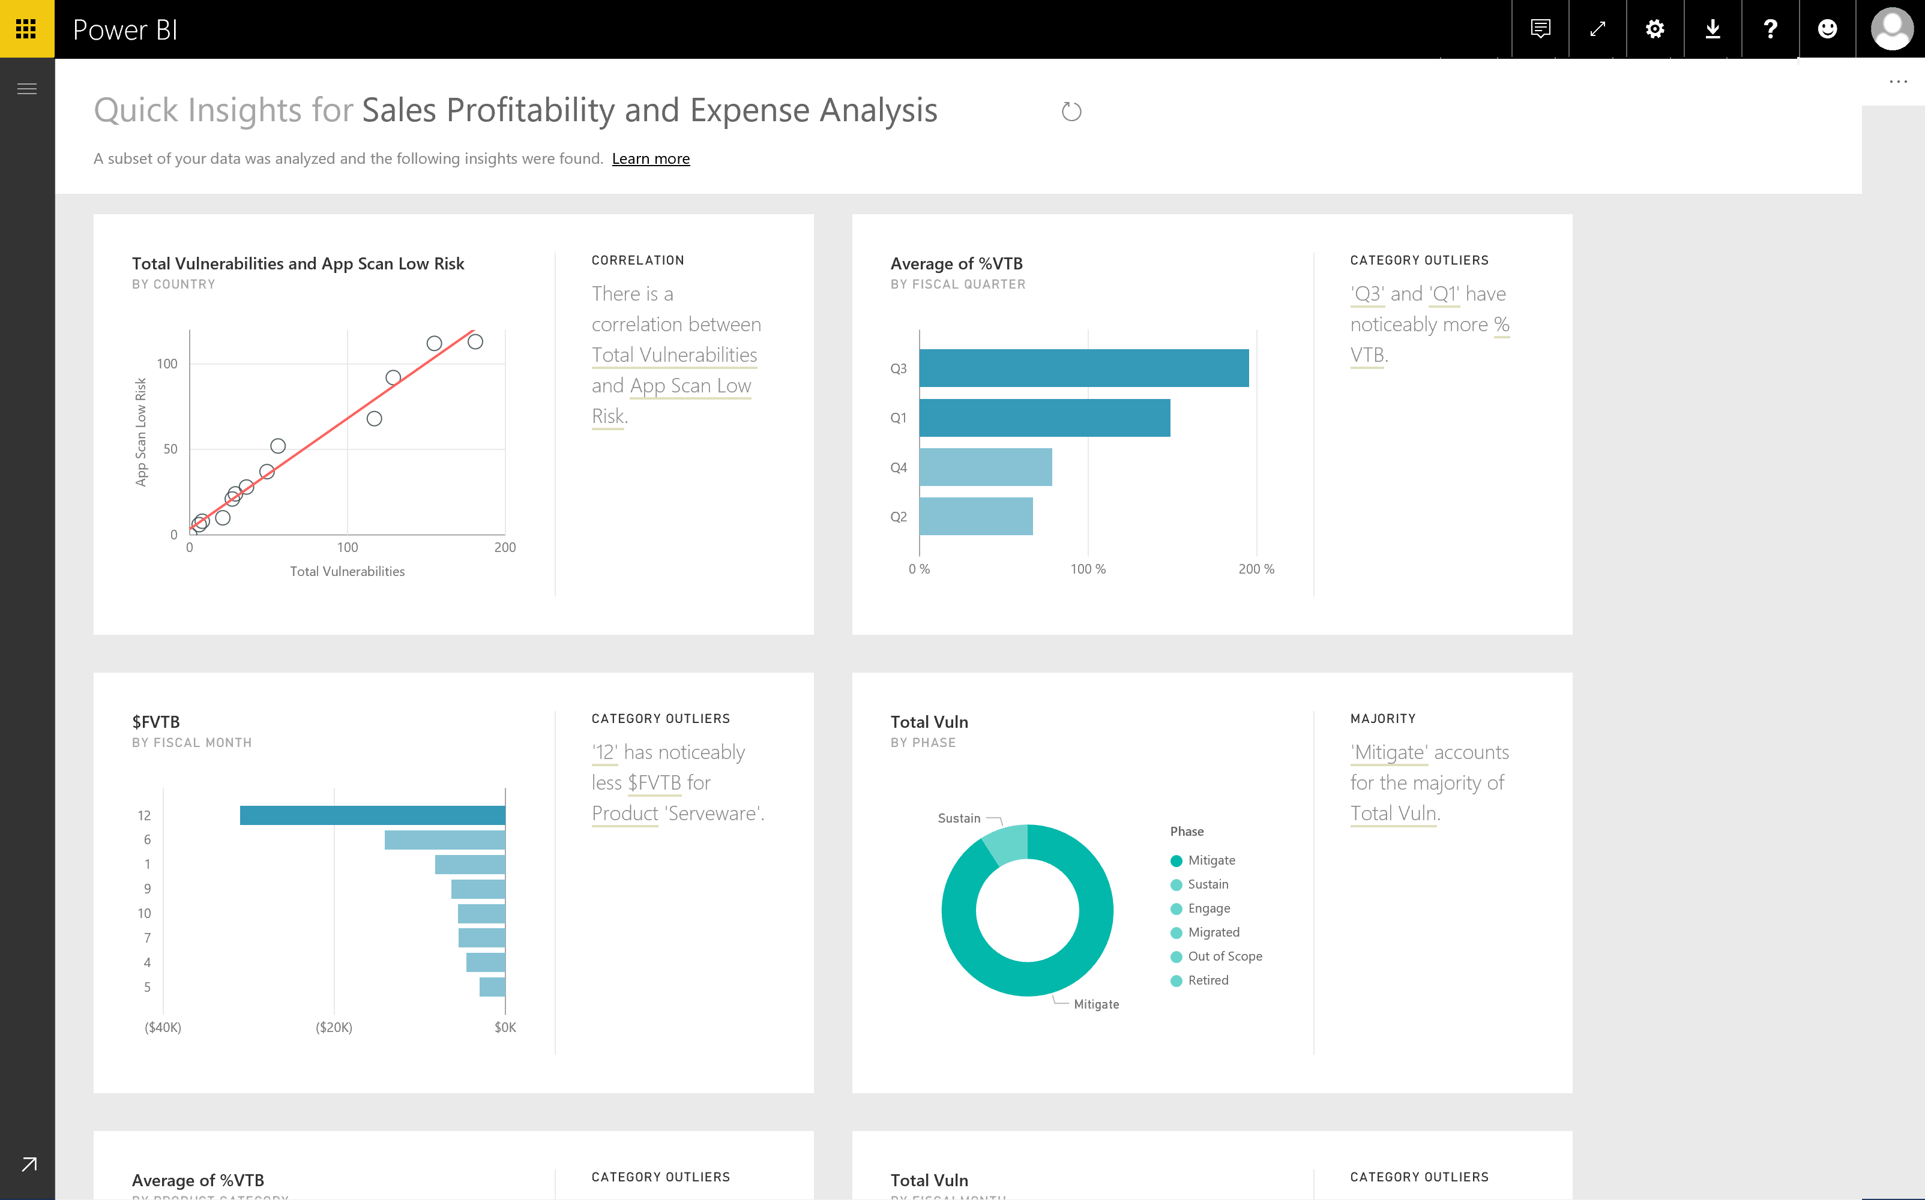
Quick Insights
abc

Slide 11
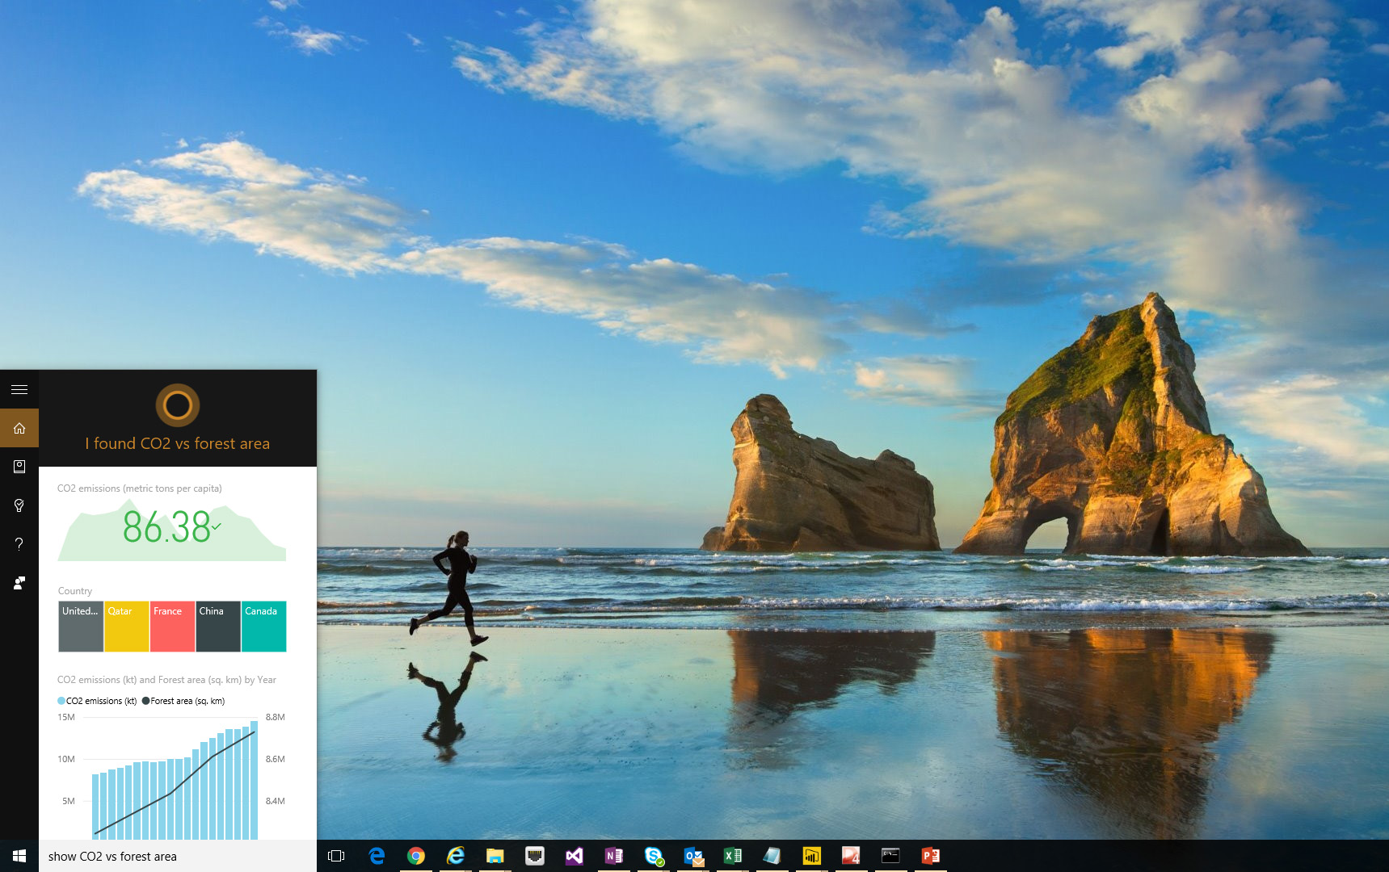
Cortana
integration
abc

Slide 12

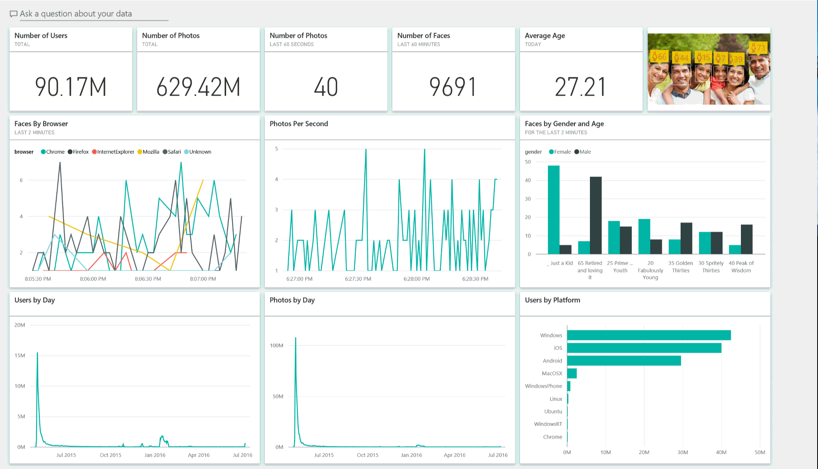
Live
dashboards
abc

Slide 13

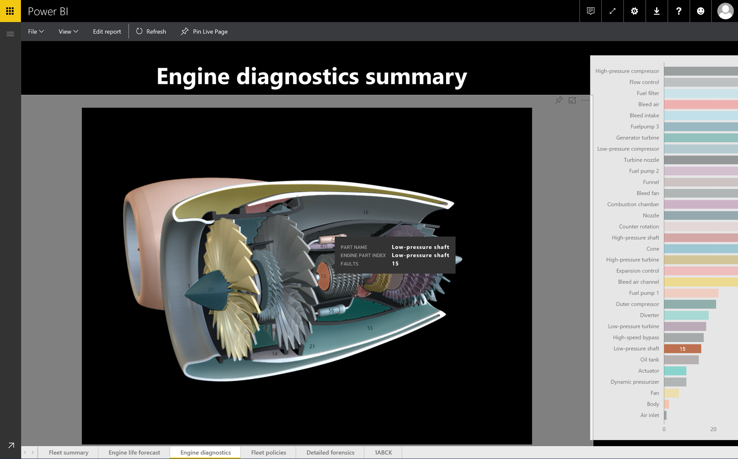
Custom visualizations
abc

Slide 14
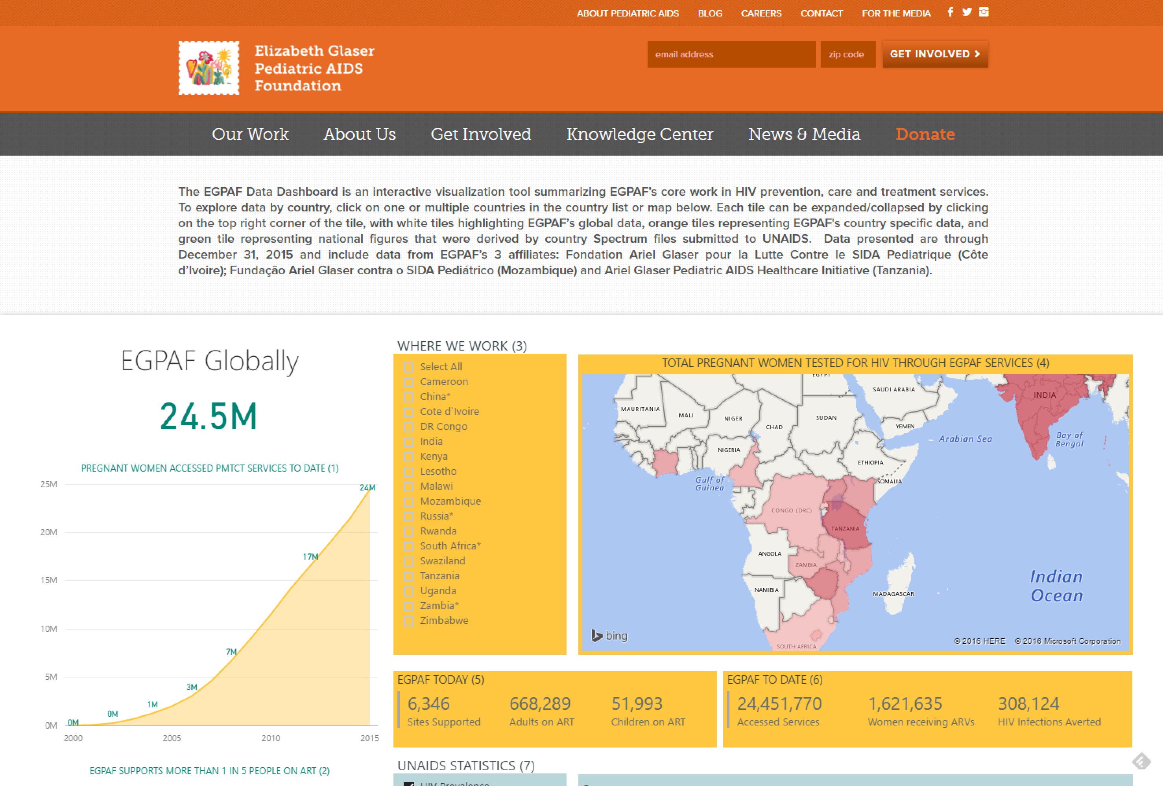
Publish to the web
abc

Slide 15
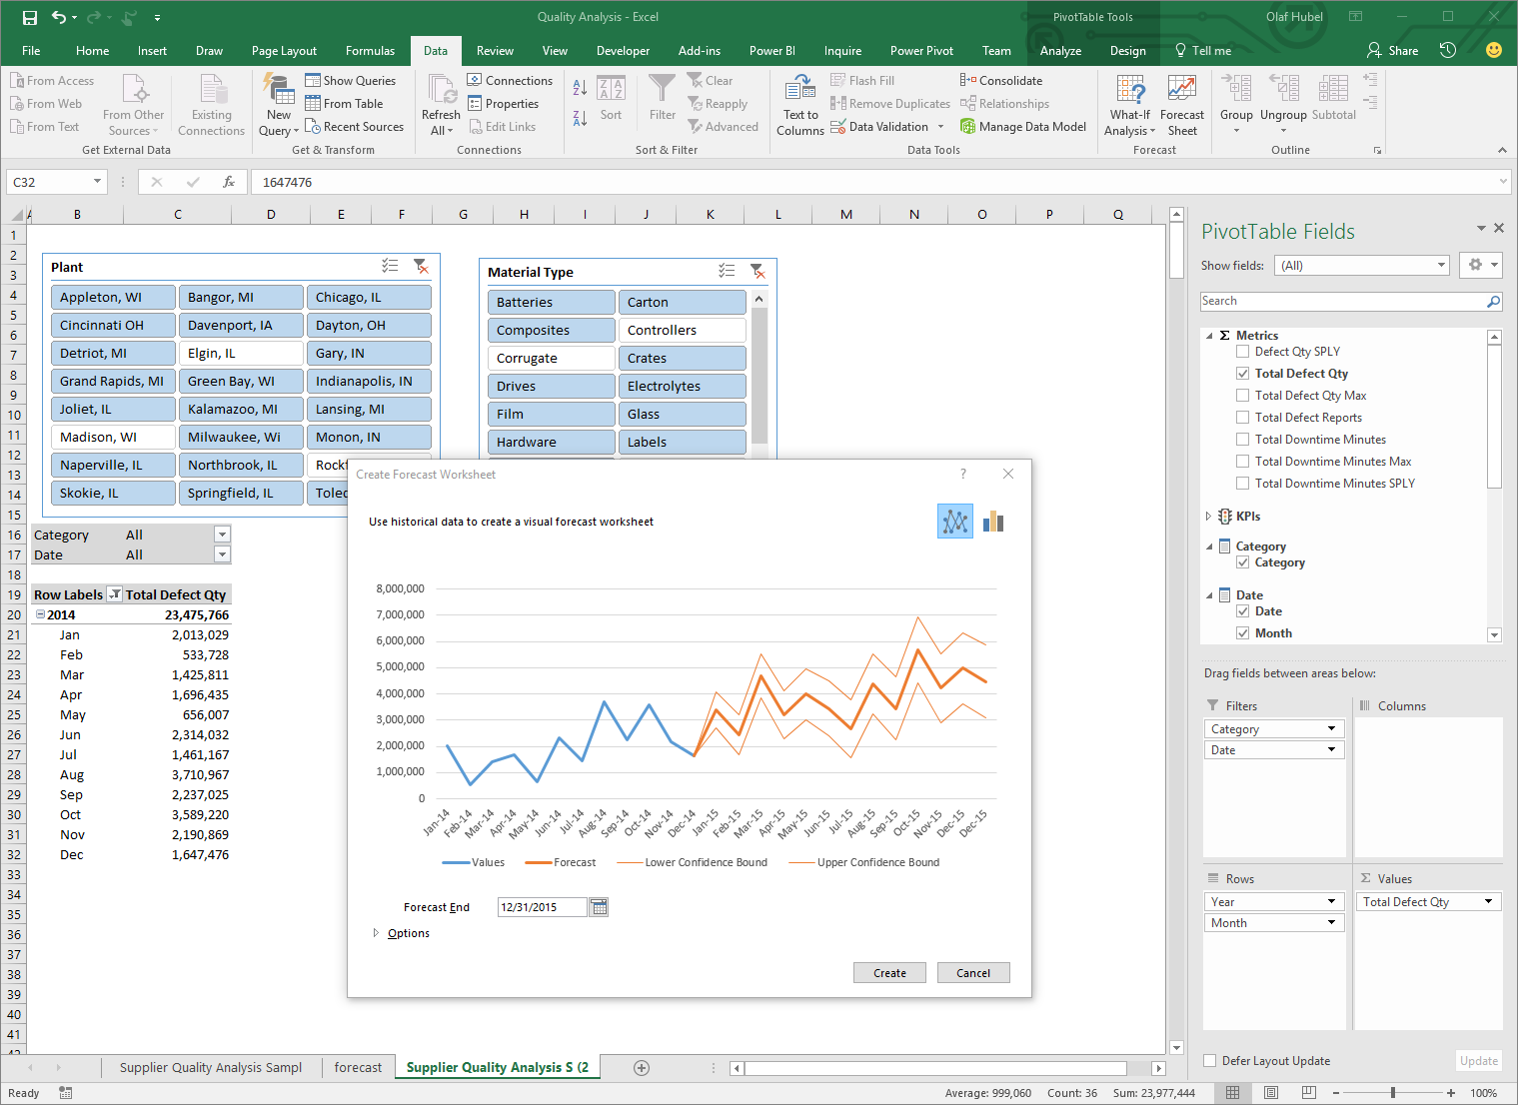

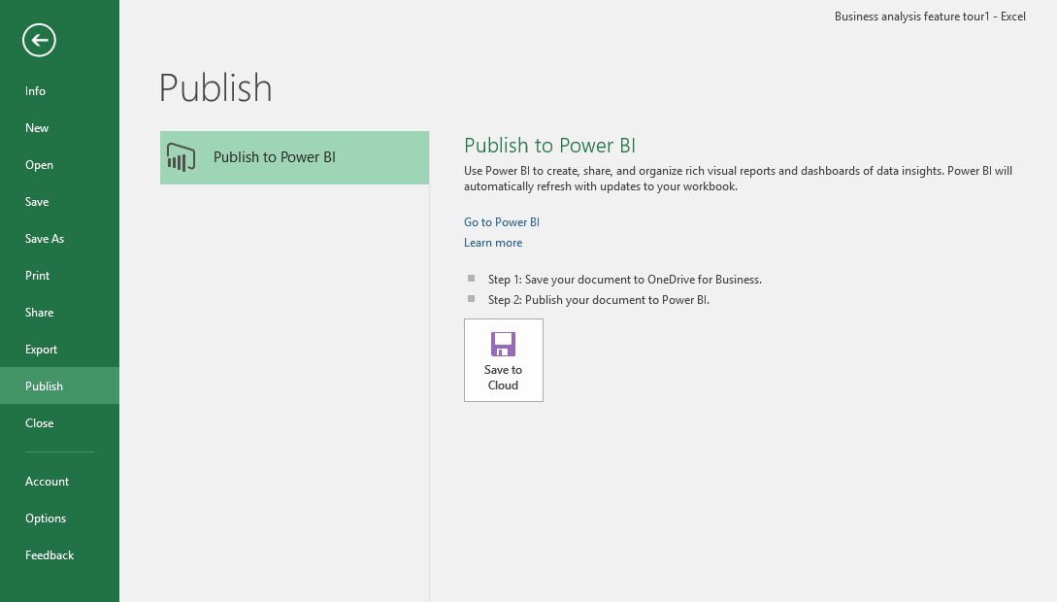
Integration with
Microsoft apps
& services
abc

Slide 16
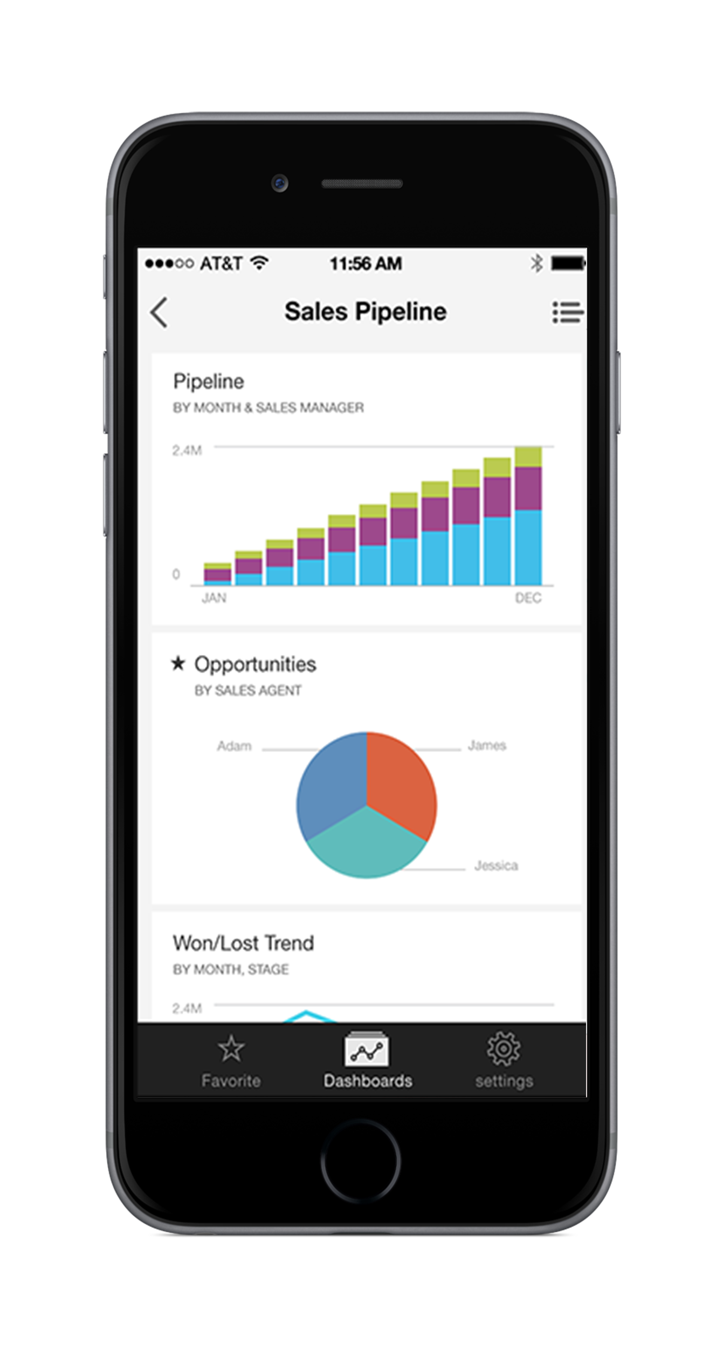
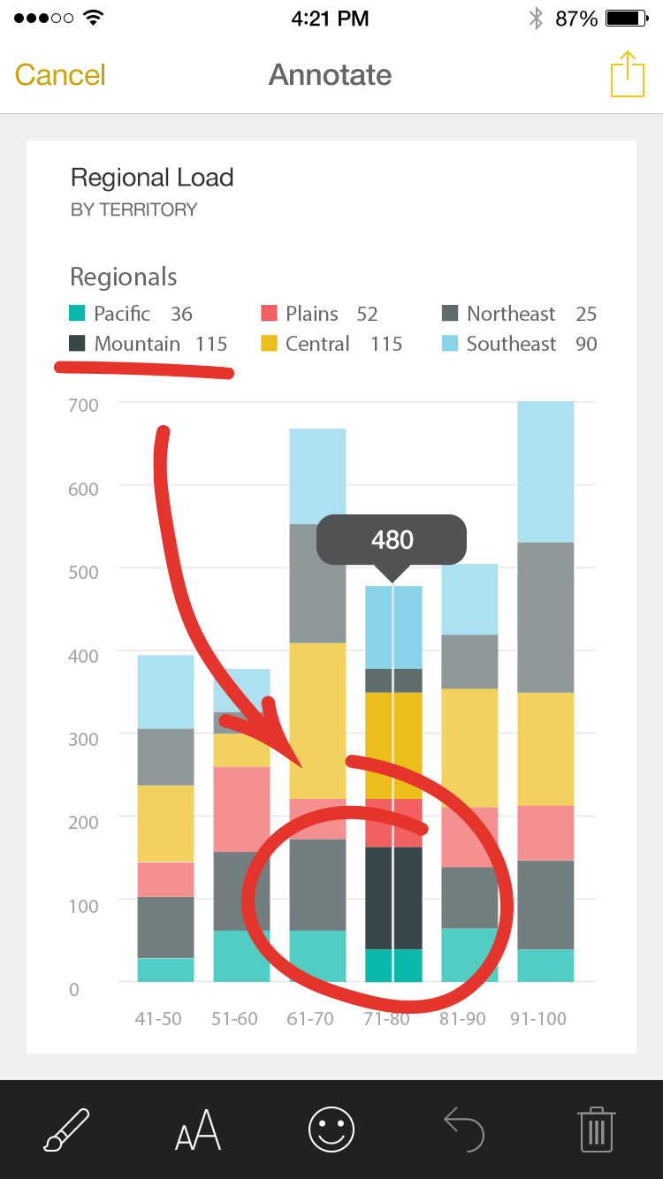
Power BI Mobile
abc

Slide 17
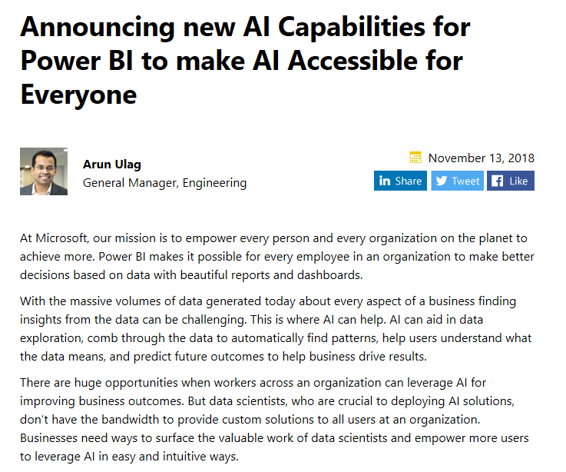

Slide 18
Power BI + AI
-Premium feature
-Users can now get capabilities such as image recognition and text analytics directly in Power BI.
-Key driver analysis helps users understand what influences key business metrics.
-Users can create machine learning models directly in Power BI using automated machine learning.
-Users now have seamless integration of Azure Machine Learning within Power BI.

Slide 19
Power BI + AI
Azure Cognitive Services capabilities in Power BI
Pre-trained machine learning models that can extract insights from data.
documents, images, and social media feeds
New Key Driver Analysis feature in Power BI
Build Your Own Machine Learning Models in Power BI
Python and R Integration

Slide 20
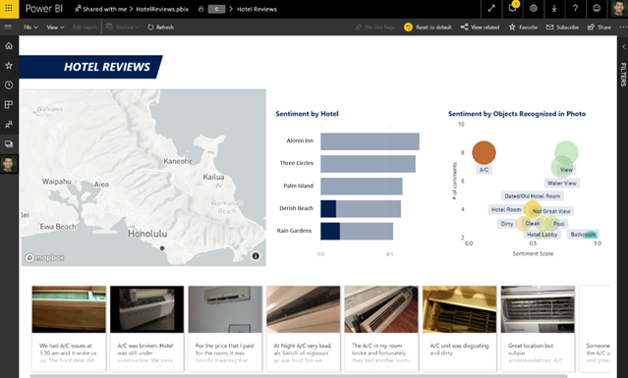
Azure Cognitive Services capabilities in Power BI

Slide 21
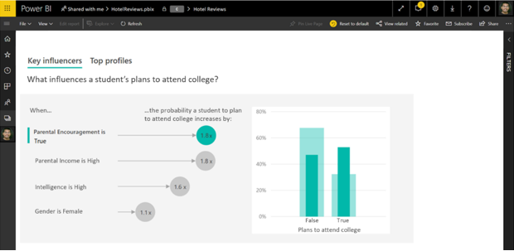
New Key Driver Analysis feature in Power BI

Slide 22
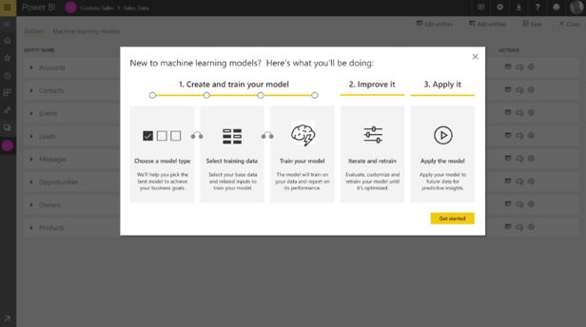
Build Your Own Machine Learning Models in Power BI

Slide 23
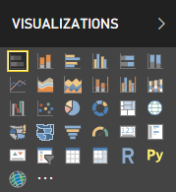
Python and R Integration

Slide 24
Demo
Notes:
-Quick Insight
-Q&A
-Bookmark
-Spotlight
-Drill Through
-Right click and Explain Increase --> Select Different chart
-Q&A in Desktop
-Improving Q&A
-POPup Q&A
-Followup Question

Slide 25
Questions?

Slide 26
Thank you!!!

